Slide 1
Johns Hopkins University CFAR Richard E. Chaisson, MD, PI Chris Beyrer, MD, MPH, Co-PI

Slide 2
JHU CFAR Specific Aims
To develop a new generation of HIV/AIDS researchers and recruit under-represented minorities into the HIV/AIDS field
To recruit new investigators from relevant disciplines into HIV/AIDS research to address the growing need for knowledge in emerging areas that affect the HIV epidemic
To enhance the productivity by promoting transdisciplinary innovation, integration and collaboration
To mobilize the capabilities and capacity of Johns Hopkins University to combat the HIV epidemic in Baltimore through training, outreach and community-based intervention studies.

Slide 3
Themes of the CFAR
Training, supporting, mentoring new investigators
Junior investigators and those not in HIV
Addressing the Baltimore Epidemic
Strengthening international collaborations and expanding junior investigator access to international research opportunities

Slide 4
CFAR Leadership
Steering Committee
Administrative Core
Scientific Advisory Board
Community Participation Advisory Committee
Diversity Committee
Clinical Core
Prevention Core
Biostats, Epi and Methods
Developmental Core
Laboratory and Biomarkers Core
Scientific Working Groups

Slide 5
Scientific Working Groups
Substance Abuse
Greg Lucas, Chair
Viral Eradication
Joel Blankson and Janet Siliciano, Co-Chairs
Bioethics and Human Rights
Nancy Kass, Jeremy Sugarman and Holly Taylor, Co-Chairs
SWG Activities:
Convene transdisciplinary researchers and service providers
Coordinate meaningful interactions between diverse disciplines
Develop collaborative research proposals

Slide 6
Developmental Core
Co-Directors: Chris Beyrer, Jackie Campbell, Andrea Ruff, Robert Siliciano
Research Grant Support:
CFAR Scholar Grant (CSG) for Faculty Development
Mentoring
Mentor support, up to $5K per year
Start-up costs for new investigators
Internal Review of grant applications
Baltimore Scholars (with Baltimore HIV Collaboratory)

Slide 7
CFAR Scholar Grant (CSG) for Faculty Development
The prime purpose of these awards is to strengthen the individual’s ability to secure independent funding
Meant as seed grants
5 NIH-funded $50K pilot/developmental grants per year
6 JHU Deans-funded $50K pilot/developmental grants per year
55 Letters of Intent received for Faculty Development Award Program last year.

Slide 8
CFAR Scholar Grant for Faculty Development Eligibility
Emphasis on new investigators across schools
Full-time Instructors, Assistant Professors in the Schools of Public Health, Medicine, or Nursing or Assistant Scientists or Assistant Lecturers in the School of Public Health at the time of application.
Post-doctoral Fellows are not eligible
If a faculty appointment is pending, a post-doc may apply with a letter from their department chair confirming this.
Associate Professors are not eligible to apply, unless they are new to HIV/AIDS research.
New to HIV/AIDS research means no prior funding of any type related to HIV/AIDS as a PI
Those in “visiting” or “adjunct” status or those pending appointment are not eligible.

Slide 9
CFAR Scholar Grant for Faculty Development Eligibility
 | SOM | BSPH | SON | CFAR Scholar Grant Eligibility
 | Professor | Professor Senior Scientist Senior Lecturer | Professor | No
 | Associate Professor | Associate Professor Associate Scientist Associate Lecturer | Associate Professor | Only if new to HIV Research
 | Assistant Professor | Assistant Professor Assistant Scientist Assistant Lecturer | Assistant Professor | Yes
 |  | Senior Research Associate
 |  | Research Associate
 | Instructor | Instructor | Instructor

Slide 10
Mentoring
Junior and minority investigators interested in developing a CFAR Scholar Grant (CSG) application may approach the Developmental Core with a request for mentorship.
The Developmental Core will assign a mentor that the applicant will contact for a meeting.
The mentor will assist the candidate through the application process, and if awarded, mentorship may continue through the completion of the developmental award.
If a development award is not funded, the mentee and mentor may decide to continue or cease the mentoring relationship as they desire.
All applicants will receive reviewer comments from the FDA application process. All applicants will be encouraged to discuss these comments with their mentor.

Slide 11
CFAR Scholar Grant for Faculty Development Application Review
6 “study sections”
Prevention Research
Clinical
Immunology, Virology and Molecular Biology
Behavioral, Substance Abuse and Social Science
Epi / Biostatistics
Community-based Research

Slide 12
CFAR Scholar Grant for Faculty Development Review Criteria (taken from NIH guidelines)
Scoring Criteria:
Significance: Does this study address an important problem? If the aims of the application are achieved, how will scientific knowledge be advanced? What will be the effect of these studies on the concepts or methods that drive this field?
Approach: Are the conceptual framework, design, methods, and analyses adequately developed, well-integrated, and appropriate to the aims of the project? Does the applicant acknowledge potential problem areas and consider alternative tactics?
Innovation: Does the project employ novel concepts, approaches or method? Are the aims original and innovative? Does the project challenge existing paradigms or develop new methodologies or technologies?

Slide 13
CFAR Scholar Grant for Faculty Development Review Criteria
Scoring Criteria (Cont.):
Investigator: Is the investigator appropriately trained and well suited to carry out this work? Is the work proposed appropriate to the experience level of the principal investigator and other researchers (if any)?
Environment: Does the scientific environment in which the work will be done contribute to the probability of success? Do the proposed experiments take advantage of unique features of the scientific environment or employ useful collaborative arrangements? Is there evidence of institutional support?
Transdisciplinary nature of the research. Proposals which successfully bring more than one scientific discipline to bear on research questions of interest will receive additional partial point scoring to encourage transdisciplinary research.

Slide 14
CFAR Scholar Grant for Faculty Development Successful applications
Important Topics in HIV Research
Scientifically Sound
Feasible to complete in 1 – 2 years
Programmatically relevant

Slide 15
CFAR Scholar Grant for Faculty Development Successful applications
Write for Reviewers
Readers will be suffering from information overload
Make organization simple, logical and easy to follow
Remind reader of the hypothesis throughout the application
Avoid a large number of acronyms
Write clearly and logically

Slide 16
2012 Developmental Award Applications
Section | Applied | Awarded
Prevention Research | 5 | 2
Clinical Studies | 11 | 4
Immunology, Virology, Molecular Biology | 15 | 3
Behavioral, SA and Social Sciences | 11 | 2
Epi and Biostats | 4 | 1
Community-based Research | 3 | 1
Total | 49 | 13

Slide 17
Immunology, Virology and molecular biology study section
Joel Blankson (presenter)

Slide 18
Our study section
We review basically all the basic science and translational science applications

Slide 19
Our study section
We review basically all the basic science and translational science applications
We received 15 applications last cycle

Slide 20
Our study section
We review basically all the basic science and translational science applications
We received 15 applications last cycle
3 were funded

Slide 21
What do we look for?
Our goal is to fund the best possible science

Slide 22
What do we look for?
Our goal is to fund the best possible science
We look for high impact proposals

Slide 23
What do we look for?
Our goal is to fund the best possible science
We look for high impact proposals
Impact defined as having a sustained influence on the field

Slide 24
What do we look for?
Our goal is to fund the best possible science
We look for high impact proposals
Impact defined as having a sustained influence on the field
We’re not as interested in proposals that do not have high impact, but can be completed easily

Slide 25
What we look for
1. Significance. Is this an important question?
2. Investigator(s). Based on stage of development
3. Innovation. How novel are the ideas and techniques?
4. Approach. Are the techniques likely to work? Have potential pitfalls been addressed 5. Environment. What kind of support is available?

Slide 26
What we look for
1. Significance. Is this an important question?
2. Investigator(s). Based on stage of development
3. Innovation. How novel are the ideas and techniques?
4. Approach. Are the techniques likely to work? Have potential pitfalls been addressed 5. Environment. What kind of support is available?
Final score is based on all of these as well as the impact of the proposal

Slide 27
Investigators new to hiv research
It’s a very good idea to find a mentor or collaborator with HIV research experience
You have to demonstrate a detailed understanding of HIV biology
Make sure you give a lot of background in your area

Slide 28
What happens to youR grant?
Study section members:
Joel Blankson
Andrea Cox
Petros Karakousis
Joseph Mankowski
Deborah Persaud
Stuart Ray
Janet Siliciano

Slide 29
What happens to youR grant?
Each grant is read by 3 members of the study section
Grant is presented at study section meeting
Members with conflict of interest will recuse themselves
All other members of section vote on the grant
Grants are then ranked based on average score

Slide 30
Clinical Laboratory and Biomarkers Core
Facilitates access to research labs, clinical labs, and core labs across the Johns Hopkins Enterprise.
Provides discounted research pricing for the performance of laboratory assays.
Offers consultation, training and technical support in laboratory practices.
Provides guidance in meeting regulatory requirements.
Offers biospecimen storage, and potential access to samples banked by other researchers.

Slide 31
Johns Hopkins University CFAR
Clinical Core (Justin C McArthur: Co-director)

Slide 32
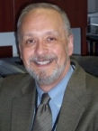
Leadership & Staff Clinical Core
Richard Moore, MD
Director, Clinical Core
Jason Farley, PhD, MPH, CRNP, FAAN
Co-director, Clinical Core
Justin McArthur, MBBS, MPH
Co-director, Clinical Core
Director, Department of Neurology
Shruti Mehta, PhD, MPH
Co-Director, Clinical Core Co-director, Substance Use SWG
David Thomas, MD, MPH
Co-director, Clinical Core
Director, Division of ID
Holly Taylor, PhD, MPH
Co-director, Bioethics and Human Rights Scientific Working Group Member, Clinical Core
Lois Eldred, DR.P.H.
Senior Manager, Clinical Core
Anitha Devadason
Senior Research Coordinator, Clinical Core

Slide 33
Clinical core: Scientific Landscape
Clinical Core
The Clinical Core provides strategic direction and infrastructure to increase patient-oriented collaborative clinical and translational research by the JHU investigative community.
Who are we?
Five co-directors from the Johns Hopkins Schools of Medicine, Nursing and Public Health, with domestic and international HIV-related research.
What is our Scientific Agenda?
Treatment and clinical progression of HIV-infection and associated opportunistic illness,
Important co-infections (TB, viral hepatitis, etc.)
Emerging non-infectious co-morbidities (cardiovascular, kidney, endocrine/metabolic, neurocognitive, and malignancy) and substance abuse.
What can we provide?
Consultation on design, implementation and analysis of clinical and translational studies
Expertise with data base management
Research coordination-
Assistance with Johns Hopkins IRB submissions
Assistance in conducting clinical and translational studies (patient recruitment, informed consent, phlebotomy, data form completion, follow-up)
International research awards for junior faculty, and those new to HIV research
Year 1 (2012-2013) focused on HIV and Aging and enabled the Clinical Core to reach across Schools and Departments to foster collaboration among young investigators and encourage researchers in aging to incorporate HIV into their portfolios.

Slide 34
Clinical core: Lecture series
Year 1: HIV and Aging
Co-sponsorship of Third International HIV and Aging Workshop
HIV and Aging Lecture Series (Link)
Special Lectures
Year 2: HIV and Co-infection
Revised Hepatitis C Screening Guidelines
HIV, Hepatitis C and Cirrhosis
Hepatitis C Vaccine Prospects
Non-invasive Tests for Fibrosis
Controversies in Treatment of Hepatitis C Town Hall Meeting
HPV and HIV Co-infections: Management and Research
New Therapies for Treatment of Tuberculosis
Other HIV-related Topics
Conducting Research in Prisons Town Hall Meeting - a co-sponsored presentation with the JHU School of Nursing course Diagnosis, Care and Management of Persons with HIV/AIDS
Co-Sponsorship of 4th International HIV and Aging Workshop

Slide 35
Clinical core: funding opportunities

Slide 36
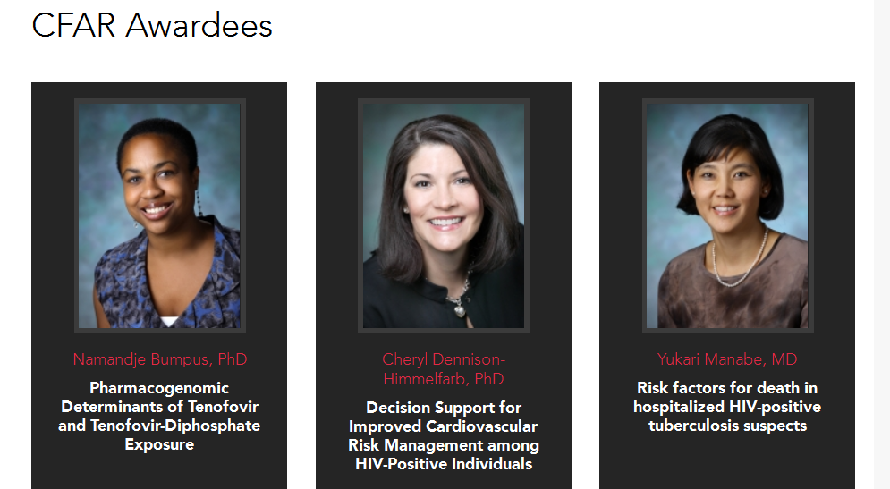
Cfar awardees: clinical core

Slide 37
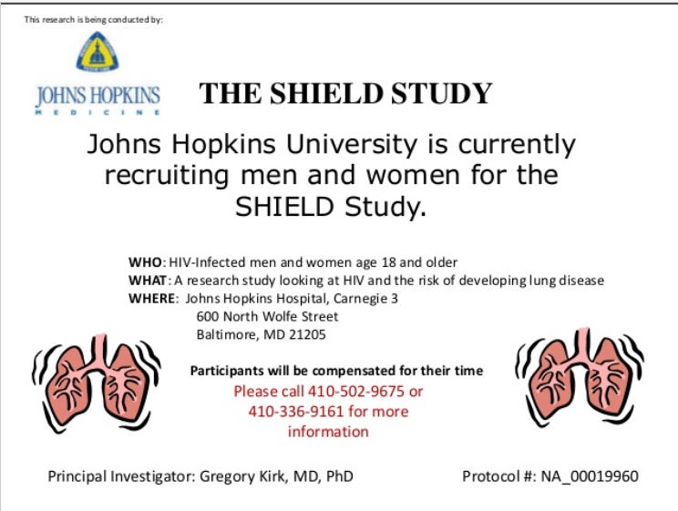
Moore clinic research studies
Anitha Devadason
Senior Research Coordinator

Slide 38
Clinical core: other resources
Cohort Studies – in addition to the MACS, led by Joseph Margolick, other highly productive cohorts led by JHU faculty include the JHU HIV Clinic Cohort and the North America Accord, led by Richard Moore, ALIVE I, led by Greg Kirk, and ALIVE II led by Shruti Mehta, HERS and WIHS, led by Steven Gange, AIM-HI led by Ned Sacktor, the Soweto Lung Cohort Study, led by Neil Martinson and Richard Chaisson, TB/HIV in Rio cohort, led by Richard Chaisson and Jonathan Golub.
All of these prospective cohort studies address the natural history of HIV and its treatment, and several include cohorts of seronegatives at risk for HIV incidence and preventive intervention studies.
Clinical Trials – JHU investigators play a leading role in conducting clinical trials of HIV treatments and preventive strategies. JHU investigators play major leadership roles in a number of trials, including Brooks Jackson as PI of the IMPAACT network and Curtis Meinert as PI of the Study of the Ocular Complications of AIDS (SOCA) network. Maria Wawer and Ron Gray led the Rakai male circumcision trial, Andrea Ruff, Taha Taha and Bob Bollinger led the SWEN trial and David Celentano and Bob Bollinger are co-PIs of HPTN 052, a study of early ART to prevent sexual transmission of HIV. A number of other R01 and network funded trials address a variety of intervention strategies and agents. DAIDS Clinical Trials Units for all of the DAIDS networks are led by JHU investigators in Baltimore, Uganda, India, Malawi and Thailand.

Slide 39
Clinical core: other resources
Institute for Clinical and Translational Research (ICTR). Under a Clinical and Translational Science Award (CTSA) the ICTR facilitates clinical and translational research at Johns Hopkins. See: http://ictr.johnshopkins.edu/ictr/. The Research Ethics Achievement Program (REAP) attends to the research ethics related aspects of the ICTR. Of special relevance to this CFAR application are the Research Ethics Consult Service (Aim 1) and the Community Engagement Working Group (Aim3).
Research Ethics Consulting Service (RECS), was started by Drs. Kass and Taylor for JHSPH and now is a component of JHU Institute for Clinical Translational Research (ICTR), and as such will be available for all JHU HIV/AIDS Researchers. RECS has a web-based portal, facilitating the request of consults by those either on campus or in remote sites. While the majority of consults through the RECS are one-time encounters regarding ethics issues emerging in the planning, conduct, or analysis of studies, the services we provide for CFAR investigators can be more sustained, as needed.

Slide 40
Clinical core: other resources
Community Engagement Working Group of the ICTR: The Community Engagement Group has recently established a community advisory group that serves the entire Johns Hopkins Medical Institutions. Dr. Kass has worked with the Community Engagement Working Group of the CTSA as part of her own involvement in the CTSA’s ethics. Dr. Kass will ensure that Baltimore Working Group activities with relevance to community involvement and engagement are not only discussed extensively with our own HIV-related community group formed for the CFAR, but also will stay in close communication with this broader community engagement board, ensuring that they disseminate information about activities, trainings, opportunities, events, and studies within their own community networks and neighborhoods as well.
The Urban Health Institute (UHI) is a collaboration and a vital connection with East Baltimore. The UHI is the starting point for forging true University and community partnerships in health care, education and community planning, with all partners working to change the trajectory for the children, youth and families of East Baltimore. The UHI draws on the expertise of neighborhood residents, educators, philanthropic organizations, elected representatives and community leaders, in addition to the wealth of intellectual resources that Hopkins can offer. See: http://www.jhsph.edu/urbanhealth.

Slide 41
Clinical core: how best to engage ?
Everyone involved WANTS you to succeed
Feel free to ask any of us for advice ~ grant submissions, manuscripts, ideas for funding
Peer mentoring of submissions
Participate in lecture series and seminars, EVEN if not in your area of interest. This is how novel collaborations develop !

Slide 42
Johns Hopkins University CFAR
Behavioral, Substance Use, and Social Sciences Study Section
Prevention Study section
(David Celentano, presenting)

Slide 43
Behavioral, Substance use and Social Sciences AND Prevention Study Sections : Scientific Landscape
Current buzz:
Combination HIV Prevention
Implementation Science
Access to care cascade
Treatment as Prevention (TASP)

Slide 44
Behavioral, Substance use and Social Sciences AND Prevention Study SectionS: programmatic areas
Techniques (e.g. circumcision, microbicides, harm reduction, HTC, stigma reduction, health communications, mHealth, structural interventions, TasP, PreP, combination prevention)
Populations
key populations (e.g., IDU, FSW, adolescents, MSM)
generalized epidemics

Slide 45
Behavioral, Substance use and Social Sciences and Prevention Study Sections: resources available
Review specific aims
Assign mentors
Facilitate collaborations
Ensure linkages to appropriate resources
Tamara Flys (tflys@jhsph.edu) and Wendy Davis (wdavis@jhsph.edu)

Slide 46
Behavioral, Substance use and Social Sciences And Prevention Study Sections: above all else
Because a new R01 is CFAR’s main metric, your research should provide preliminary data needed to successfully compete for R series awards.
You need to clearly demonstrate that what you propose will lead to an RO1!

Slide 47
Behavioral, Substance use and Social Sciences and Prevention Study Sections: how we score
Significance
Approach
Innovation
Investigator
Environment
Transdisciplinary

Slide 48
Behavioral, Substance use and Social Sciences and Prevention Study Sections: A Success story
mHealth-Enhanced Economic Empowerment Initiatives for HIV Prevention among Youth Living in Urban Slums in Kenya (Larissa Jennings)
Specific Aim 1: To characterize local and gendered representations of economic empowerment, its influence on HIV vulnerability, and the role of mobile phone technology among Kenyan’s urban slum youth
Specific Aim 2: To assess HIV-related sexual behaviors, mobile phone use, and economic status among Kenyan’s urban slum youth, including development and testing of an HIV-contextualized economic empowerment scale.

Slide 49
Behavioral, Substance use and Social Sciences and Prevention Study Sections: another Success story
Improved vaginal delivery of Dapivirine using mucus-penetrating nanoparticles for prevention of HIV infection (Laura Ensign)
Specific Aim 1: Develop biodegradable, mucus-penetrating nanoparticles (MPPs).
Formulate Dapivirine-loaded MPP using biodegradable polymers.
Confirm that Dapivirine-MPP rapidly penetrate fresh, undiluted hCVM and mCVM on freshly excised ex vivo vaginal tissue.
Ensure that Dapivirine-MPP exhibit sustained release (at least 24 h) while satisfying Aim 1B.
Specific Aim 2: Test Dapivirine-MPP for vaginal distribution and retention in the mouse
Confirm that Dapivirine-MPP can provide uniform distribution in the mouse cervicovaginal tract.
Investigate the effects of delivering Dapivirine-MPP in hypotonic gels to achieve rapid vaginal distribution and prolonged retention in mice.
Perform initial toxicity tests with Dapivirine-MPP in hypotonic and hypertonic gel vehicles by measuring inflammatory cytokine release.

Slide 50
Behavioral, Substance use and Social Sciences and Prevention Study Sections: in the end
We want you to succeed!
You getting an RO1 helps us keep the CFAR at Hopkins

Slide 51
Johns Hopkins University CFAR Biostatistics and Epidemiology Methodology Core (BEM)

Slide 52
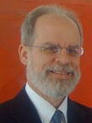
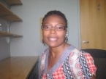
Larry Moulton Bryan Lau Richard Thompson Aletta Nonyane Owen Amadin
Director Co-director for Co-director for Biostatistics Research Program
Epidemiology Biostatistics Consultant Administrator
Lmoulton@jhsph.edu brlau@jhsph.edu rthompso@jhsph.edu bnonyane@jhsph.edu oamadin@jhsph.edu
410-502-9327
Core Team of the
Biostatistics and Epidemiology Methodology Core (BEM)

Slide 53
What services do we offer?
The BEM Core provides state-of-the-art epidemiological and biostatistical services in support of innovative HIV/AIDS research to improve the understanding of the pathogenesis, prevention and management of HIV disease and its complications by:
Linking investigators with BEM Core members who can contribute their expertise in HIV/AIDS epidemiology and methodology, including the construction of study protocols and selection of study design, constructing inclusion/exclusion criteria, working with statistical programmers and data management staff, developing and executing statistical analysis plans, writing research reports and manuscripts and contributing to scientific presentations.
Providing support for data management through the JHBC Data Informatics Services Core.

Slide 54
Current Faculty Development Awardees
Efficiency and Yield of Contact Investigations for TB in Heterogeneous, HIV-Driven Epidemics.
David Dowdy, Dept. of Epidemiology, Bloomberg SPH.
Estimating the Minimum Dosing Frequency of Pre-Exposure Prophylaxis Needed to Provide a High Level of Protection Against HIV Infection.
Michael Rosenblum, Dept. of Biostatistics, Bloomberg SPH.

Slide 55
Criteria for Awards
Standard criteria: Significance, Approach, Innovation, Investigator, Environment, Transdisciplinary
Importance of subject/potential for follow-on grants.
Finite: can be done in relatively short time-frame with limited funding.
Focus is on methodological innovation, or translational work that brings methods from one field to another; pure subject-matter applications may be better off going to other Cores.

Slide 56
Two slides of general advice
Many grants have statistical review—statisticians will go to the Sample Size section to see what is really important to the investigator and whether the main study goals have been distilled enough that they can be addressed with straightforward analyses.

Slide 57
Top 4 Reasons Proposals to NIH are Rejected
The problem is not of sufficient importance or is unlikely to produce any new or useful information.-----33.1%
The proposed tests, or methods, or scientific procedures are unsuited to the stated objective.-----34.7%
The description of the approach is too nebulous, diffuse, and lacking in clarity to permit adequate evaluation.-----28.8%
The investigator does not have adequate experience or training for this research.-----32.6%
--From analysis of 605 rejected proposals; Dr. Ernest M. Allen (Chief of the Division of Research Grants, National Institutes of Health)Science, Vol. 132, 1960), pp. 1532-4

Slide 58
Larry Moulton Bryan Lau Richard Thompson Aletta Nonyane Owen Amadin
Director Co-director for Co-director for Biostatistics Research Program
Epidemiology Biostatistics Consultant Administrator
Lmoulton@jhsph.edu brlau@jhsph.edu rthompso@jhsph.edu bnonyane@jhsph.edu oamadin@jhsph.edu
410-502-9327
Core Team of the
Biostatistics and Epidemiology Methodology Core (BEM)

Slide 59
Johns Hopkins University CFAR
Community Study Section (David Holtgrave, presenting)

Slide 60
Community Study Section: Scientific Landscape
Community-based Participatory Research (CBPR)
“Collaborative approach to research that equitably involves all partners in the research process and recognizes the unique strengths that each brings. CBPR begins with a research topic of importance to the community with the aim of combining knowledge and action for social change to improve community health and eliminate health disparities.”
W.K. Kellogg Community Scholar’s Program (2001)

Slide 61
Community Study Section: Relevant Programmatic areas
Timely scientific studies that approximately meet the above definition of CBPR and can show real evidence of community involvement
Location: Baltimore or around the globe
While all timely scientific areas are most welcome, the nature of CBPR will likely tend toward prevention, care, housing and structural intervention studies
Last year, 3 researchers applied to this study section; 1 was successful in receiving funding
“Developing and Piloting a Gender-based Violence Intervention Module to Reduce HIV Risk Among FSWs”
Dr. Michele Decker

Slide 62
Community study section: resources available
Baltimore HIV Collaboratory (please see CFAR website) maybe of help in identifying leads to strategic community partnerships
Baltimore HIV Collaboratory and other Cores maybe of assistance in discussing resources for researchers relatively new to CBPR

Slide 63
Community Study Section: A word to the wise
Please note, however, the type of relationships necessary for true CBPR research take time to build. Community partners are not engaged overnight, trust is not built in a week, and real engagement is not “manufactured”…it is earned over a substantial period of time
Proposals which offer only promissory notes for community engagement will almost surely not be funded; some real evidence of at least strong initial community engagement is needed (a letter of meaningful support from a community partnering organization, for example, would be extremely helpful)
When it comes to evidence of real community partnership, more is definitely better

Slide 64
Community study section: even more words to the wise
Key issues:
Does the community want and prioritize this research topic area?
How do we know? Who said?
Who are the partnering community members and/or organizations?
What does that partnership look like? How has it been engaged so far? How will it be sustained over time? Who gets what out of the partnership?
How will the conduct of the research involve these community partners?
How will the research benefit the partners? How will the partners help interpret the results?
How will the research be disseminated? Will Hopkins work with partners to ensure the key programmatic and policy decision makers know of this (hopefully) actionable research?
Will all journal publications and future grant proposals honor and respect the initial community partnerships?

Slide 65
Community Study Section: Ending where we started
Community-based Participatory Research (CBPR)
“Collaborative approach to research that equitably involves all partners in the research process and recognizes the unique strengths that each brings. CBPR begins with a research topic of importance to the community with the aim of combining knowledge and action for social change to improve community health and eliminate health disparities.”
W.K. Kellogg Community Scholar’s Program (2001)

Slide 66
CFAR Scholar Grant Application Process
Anne Efron, MSN, MPH
CFAR Project Administrator

Slide 67
CFAR Scholar Grant for Faculty Development
Studies that cannot be funded through CFAR:
New drugs, treatments or devices
Off-label use of a licensed drug
Require additional NIH review:
Involve licensed drugs, treatments or devices
Deemed above minimal risk by the institutional IRB
Involve vulnerable populations
Involve behavioral interventions
Any International Study

Slide 68
CFAR Scholar Grant for Faculty Development
Do not require additional NIH review:
Routine blood draws
Non-invasive procedures routinely employed in clinical practice (e.g. ultrasound, MRI)
Surveys, focus groups
If you are submitting the same proposal to another funding mechanism, you must describe it in the application. You may not receive funding outside of CFAR for the same proposal.

Slide 69
CFAR Scholar Grant for Faculty Development Applications
Letter of Intent Due: September 3, 2013
Title of proposal
200 word abstract
Discipline of study
Key words regarding topic (HIV/AIDS assumed)
Name of mentor or request for CFAR to assign
Not required, but helps plan reviewers, assign mentors and puts you on the mailing list for updates
Submitted by e-mail to: cfar@jhmi.edu
subject heading “CSG Letter of Intent”
The letter should be a Word document
File name should be “CSG_LOI_your last name”.

Slide 70
CFAR Scholar Grant for Faculty Development Application Format
Application Due date: October 1
Application form
6 page Project Narrative:
Abstract (250 words)
Introduction (1 page)
Specific Aims (½ page)
Methods (3 ½ pages)
Significance (½ page)
Budget (Justification not required)
Figures, references, letters of collaboration
Biosketch
NO COVER LETTER

Slide 71
CFAR Scholar Grant for Faculty Development Online Application Process
In development. Watch for an announcement, check newsletter and website for instructions.
Application Cover form will be completed on line
Elements of Project narrative are to be merged into one PDF in the order described on the previous slide and uploaded.

Slide 72
CFAR Scholar Grant for Faculty Development Application
Research Project Information
Project Title:
Location (City/Country) of the Project:
Please name other Hopkins collaborators and their affiliations. Include your project mentor:
Name (including degrees) | School | Department | Role

Slide 73
CFAR Scholar Grant for Faculty Development Application
Have you submitted an application for funding for the project described in this application to another program in addition to the Center For AIDS Research? If YES, please list and describe all:
Does this project involve: Human subjects? Vertebrate animals?
Total Budget Request: | Your Department Financial Administrator name and e-mail NAME E-MAIL
Name(s) of reviewers Applicant does NOT want to review application with explanation:

Slide 74
CFAR Scholar Grant for Faculty Development Application
Review Criteria | Application
Significance | Project Narrative - Significance
Investigator | Biosketch - Personal Statement
Innovation | Narrative - Introduction
Approach | Narrative - Methods
Environment | Narrative - Methods (Resources)

Slide 75
CFAR Scholar Grant for Faculty Development What to expect if funded
You will receive an e-mail notice shortly before World AIDS Day
Awardees will be announced publically on World AIDS Day (December 2, 2013)
Formal letter with reviewer comments
Earliest possible start time is January 1, 2014
Transfer of funds will start to take place
You will receive an e-mail with confirmation that funds have been transferred

Slide 76
CFAR Scholar Grant for Faculty Development What to expect if funded
If International Study - Will need to complete NIH International Checklist and provide:
Foreign collaborators information and budget for foreign component - if more than one site, need info for all sites
FWA for Foreign site – exact site (i.e. clinic name)must be listed under the FWA for approving foreign institution
HSR certificates
IRB approvals – domestic and foreign

Slide 77
CFAR Scholar Grant for Faculty Development What to expect if funded
If Clinical Study - Will need to complete NIH Clinical Research Checklist and provide:
HSR Certificates
IRB approval
FWA
Protocol
Informed consent
SAE plan
If International Clinical Study – Will need to complete both reviews

Slide 78
CFAR Scholar Grant for Faculty Development What to expect if funded
Present at a CFAR Leadership Meeting
Present talk or poster at the annual CFAR meeting (June)
Present at a Research in Progress Meeting
Participate as a reviewer for future CFAR Scholar grant applications
Cite the CFAR in any presentation or publications resulting from the funding

Slide 79
CFAR Scholar Grant for Faculty Development What to expect if not funded
With letter of notice, you will receive the comments from reviewers. Highly recommend meeting with your mentor to review.
Contact the appropriate CFAR core to assist you further with your idea.
Watch CFAR announcements for other funding opportunities (International Scholars Awards)
Apply again next year

Slide 80
Website
HopkinsCFAR.org/faculty-development-awards
Instructions, forms/templates, FAQs
More information on NIH requirements for International studies and Clinical Trials
NIH Application Guide
Past recipients
Anything not answered in these documents, contact Anne Efron – aefron@jhmi.edu

